Slide 1
English
Unit 2 – Sport
WALT:
6Wc.01: Write, with support, short texts which describe people, places and objects, and routine past and present actions and events.

Slide 2



WALT: Write, with support, short texts which describe people, places and objects, and routine past and present actions and events.
I can write 4 headings for my biography.
I can add information in the form of notes to my headings.
I can give examples of each of the success criteria that I will use in my biography.

Slide 3
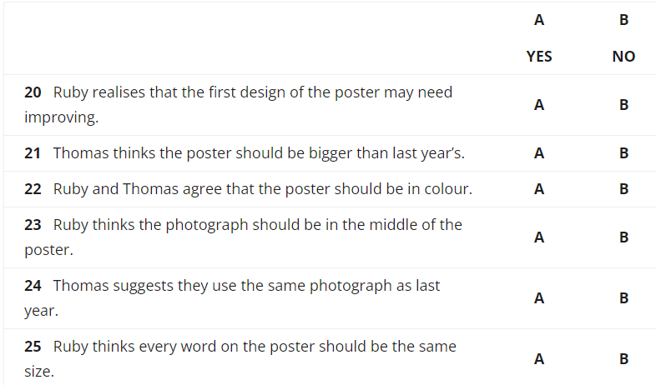
Retrieval Practice
WALT: Write, with support, short texts which describe people, places and objects, and routine past and present actions and events.
https://englishpracticetest.net/practice-listening-test-for-b1-with-answer-and-audioscript-test-01/

Slide 4
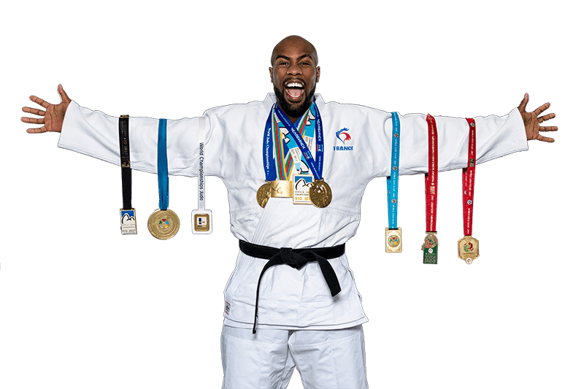
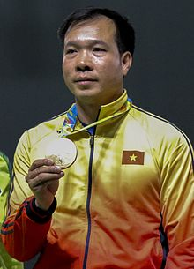
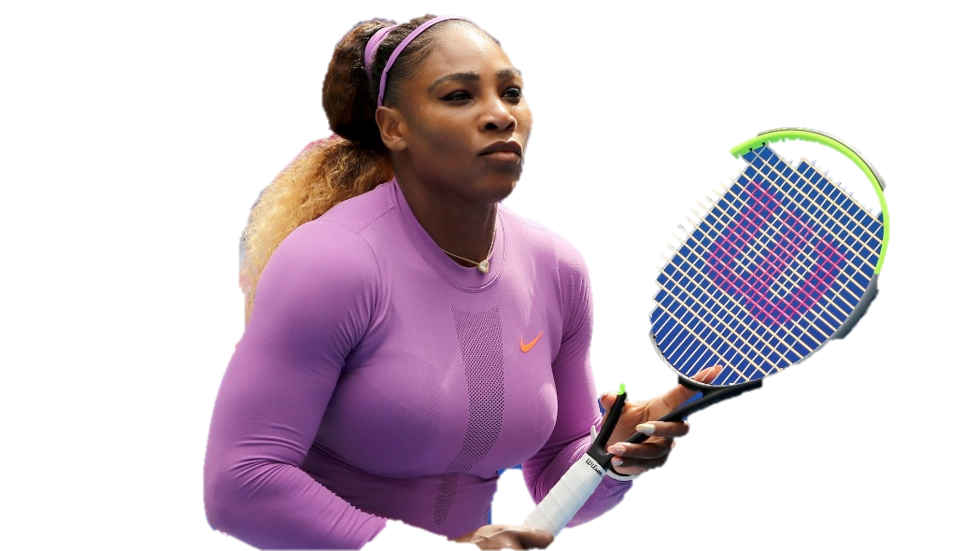
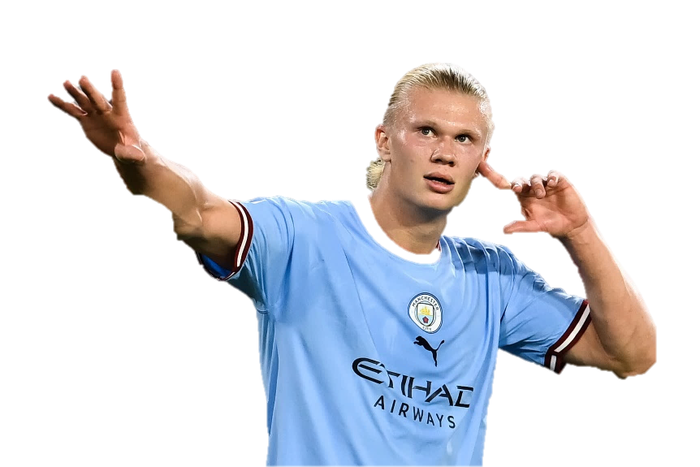
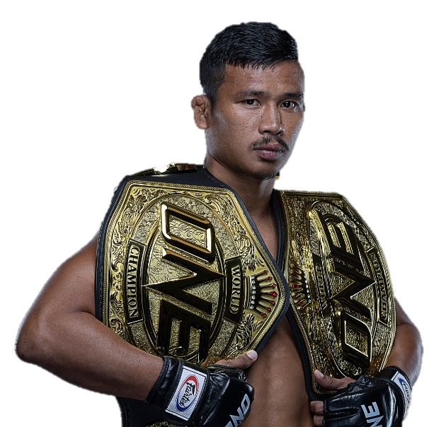
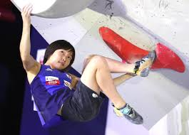
Starter – Which sports star did you research?
WALT: Write, with support, short texts which describe people, places and objects, and routine past and present actions and events.

Slide 5
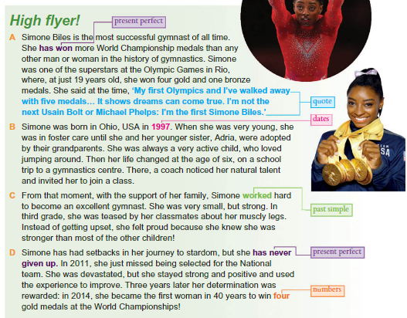
WALT: Write, with support, short texts which describe people, places and objects, and routine past and present actions and events.
Read this example of a biography.
Page 34.

Slide 6
Plan your biography now.
WALT: Write, with support, short texts which describe people, places and objects, and routine past and present actions and events.
Think of 4 headings for 4 paragraphs that you want in your biography.
For example:
Early Life
Journey to Stardom
Challenges Faced
Present Day Success

Slide 7
Now under each of your headings write some notes about your sports star.
WALT: Write, with support, short texts which describe people, places and objects, and routine past and present actions and events.
Example:
Michael Phelps
Early Life
Born June 30th 1985
Born in Baltimore, USA
When he was 7, he learnt how to swim.
Said as a kid he started swimming “because he needed to learn how to swim but then my sisters and I fell in love with the sport."

Slide 8
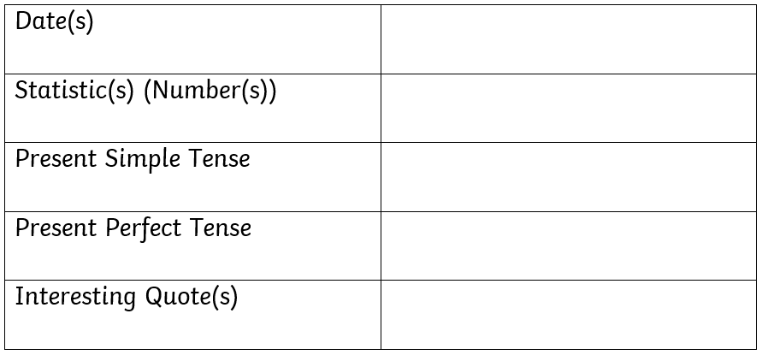
WALT: Write, with support, short texts which describe people, places and objects, and routine past and present actions and events.
Michael Phelps
Born 30/6/1985. Won first Olympic gold medal in 2004.
28 Olympic medals (23 gold)
26 World Championship gold medals.
1.93 metres tall. Wingspan 2.03 metres.
His nickname is “Teddy Bear”.
He lives in the USA.
He has held the world record the most decorated Olympian ever. He has faced many challenges in his life.
“If you want to be the best, you have to be willing to do things over people aren’t.”

Slide 9
WALT: Write, with support, short texts which describe people, places and objects, and routine past and present actions and events.
I can write 4 headings for my biography.
I can add information in the form of notes to my headings.
I can give examples of each of the success criteria that I will use in my biography.

Slide 10

Plenary - Next lesson, you will write your biography.
WALT: Write, with support, short texts which describe people, places and objects, and routine past and present actions and events.
Do you feel like you are prepared?
What can you do if you are not prepared?

